Slide 1
SEC555
Modern Log Parsing and Enrichment
Justin Henderson (@SecurityMapper) & John Hubbard (@SecHubb)

Slide 2


About Us
Justin Henderson
SEC555 Author / SEC511 Instructor
GSE #108
John Hubbard
SEC555 / SEC511 Instructor
SOC Lead, GMON | GREM | GPEN

Slide 3
Welcome!
A copy of this talk is available at: https://github.com/SMAPPER/presentations
More free stuff: https://github.com/HASecuritySolutions

Slide 4
Modern Log Parsing
Ideally want a tool that can:
Take input from a variety of sources
Parse many formats with ease
Apply enrichments to log contents
Output in a variety of formats
Integrate with 3rd party plugins
Buffer logs during volume spikes

Slide 5

Logstash
Free, developed and maintained by Elastic
Pros
Integrates with Beats
Integrates with Elasticsearch
Tons of features
Easy to learn and use
Strong performance
Built-in buffering
Cons
Requires Java
64 GB per node recommendation
Troubleshooting
Native back pressure support for Elasticsearch
Notes:
Logstash is a free tool that is great at all of this
Logstash has an easy modular plugin format
Allows us to parse and enrich logs in a number of very useful ways
Provides ability for community to write plugins
Also provides backpressure when used with Beats agents, and buffers logs to disk if desired
Doesn't need to use Elasticsearch - Can go in front of any SIEM or stand alone

Slide 6



Logstash – The Ingestion Workhorse
Beats
Syslog
Other
TCP
UDP

Slide 7


Input -> Filter -> Output
Logstash has 3 components:
Input - Methods to listen for and accept logs
Filter - Filters, parses, and enriches logs
Output - Sends logs to another system or program
Logstash Pipeline
Input plugins
Filter plugins
Output plugins
Log source
Log destination

Slide 8
Input Plugins
Input receives logs in various formats
Key plugins:
Common options – beats, syslog, file, http, tcp, udp, elasticsearch
Database – jdbc, sqlite
Message Brokers – kafka, redis, rabbitmq
Input plugins
Filter plugins
Output plugins

Slide 9
Filter Plugins
Filter section parses, filters, and enriches logs
Key plugins:
Parsing - csv, grok, kv, json, syslog_pri, xml, date
Log filtering - drop
Enrichment - dns, elasticsearch, geoip, mutate, rest, oui, useragent, tld, and ruby
Input plugins
Filter plugins
Output plugins

Slide 10
Output Plugins
Output steers parsed logs to multiple destinations
Key plugins:
elasticsearch – For storage
stdout – for debugging and development
3rd party applications - email, irc, csv, kafka, rabbitmq, graphite, google_cloud_storage, jira, nagios, pagerduty, sns, tcp/udp
Input plugins
Filter plugins
Output plugins

Slide 11
Traditional Logging - Syslog
<81>Jan 4 14:43:13 logparse sudo: jhenderson : 1 incorrect password attempt ; TTY=pts/1 ; PWD=/var/log ; USER=root ; COMMAND=/bin/su
PRI = <81>
Time/date = Jan 4 14:43:13
Source host = logparse
Source process = sudo
Message = jhenderson : 1 incorrect password attempt ; TTY=pts/1 ; PWD=/var/log ; USER=root ; COMMAND=/bin/su

Slide 12
Using Regex
Log example:
1000 failed logons against administrator
Regex pattern:
^[0-9]+ failed logons against [a-zA-Z]{3,}
Fields require pre-meditated parsing
What happens if a new one is added?
Notes:
Point out the caret

Slide 13
The Problems With Syslog
Syslog is far from ideal…
Non-standardized format, manual regex required
Wrong regex? No parsing
No pre-made regex? No parsing
Poor regex? Poor performance = Low EPS
Grok eases pain of writing statements, but still regex
Ideally new log formats should be used when available
Which ones?

Slide 14

Log Standardization
Better log formats are becoming more prevalent
Comma Separated Values (CSV)
Extensible Markup Language (XML)
But typically not for logs shipped to a SIEM
JavaScript Object Notation (JSON)
Quickly becoming the new standard
Logstash has plugins for these log formats
They are csv, xml, and json

Slide 15
csv - Filter Plugin
Delimited values can be automatically extracted
csv {
columns => ["src_ip","src_port", "dst_ip","method","virtual_host","uri"]
}
"10.4.55.1","50001","8.8.8.8","GET","sec455.com","/page.php"

Slide 16
kv - Filter Plugin
Syslog is still the most common transport method
Unfortunately does not force standardization
Standardization inside syslog is becoming more common
Example: Firewall log message uses key : value pairs
kv {
value_split => "="
}
Example log message:
src_ip=10.0.01 src_port=50001
dst_ip=8.8.8.8 dst_port=53
policyid=17 action=allow

Slide 17
kv + Logstash: Easing syslog pain
<81>Jan 4 14:43:13 logparse sudo: jhenderson : 1 incorrect password attempt ; TTY=pts/1 ; PWD=/var/log ; USER=root ; COMMAND=/bin/su
Applying logstash config:
"severity" => 1,
"syslog_severity_code" => 5,
"syslog_facility" => "user-level",
"syslog_facility_code" => 1,
"program" => "sudo",
"message" => "jhenderson : 1 incorrect password attempt ; TTY=pts/1 ; PWD=/var/log ; USER=root ; COMMAND=/bin/su\n",
"priority" => 81,
"logsource" => "logparse",
"USER" => "root",
"syslog_severity" => "notice",
"@timestamp" => 2017-01-04T19:43:13.000Z,
"TTY" => "pts/1",
"COMMAND" => "/bin/su\n",
"PWD" => "/var/log",
"facility" => 10,
"severity_label" => "Alert",
"facility_label" => "security/authorization"
input {
syslog {}
}
filter {
kv {}
}
Notes:
What if 2 words?
What if format is not as expect?
Works nice in this format, but fragile to change
Could make more efficient with a csv filter on semi-colon first, but config would be longer

Slide 18
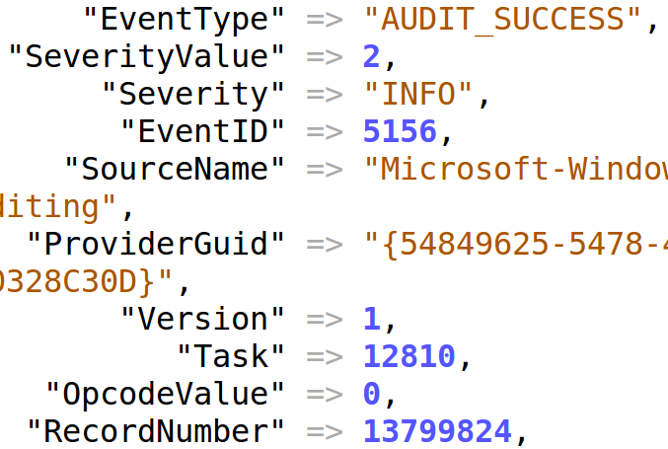
json - Filter Plugin
The easiest….the json plugin
json {
source => "message"}
}
That's all!
Windows logs have lots of fields, let JSON handle it!
Notes:
You don't even need the source parameter, that's implied
All fields are automatically taken in perfectly
The only problem is…does your Windows log agent output in JSON?
Sure hope it isn't syslog… it won't be as neat as the previous example, each field could be a multi-line mess.

Slide 19

Enrichment Plugins
Once fields are cleaned up it's time for enrichment!
dns - Performs forward or reverse name lookups
geoip - Adds geo information such as country and state
elasticsearch - Pulls back fields from other logs
rest - Makes REST style calls to 3rd party applications
ruby - Perform ruby script calls to do anything
translate - Replaces value with lookup

Slide 20
dns - Filter Plugin
dns {
reverse => [ "source_ip" ]
resolve => [ "hostname" ]
}
IP Address Domain Name
Beware potential massive impact on performance!
From 0.001 ms to 2 ms or 200 times slower
Use tactically, not for everything

Slide 21
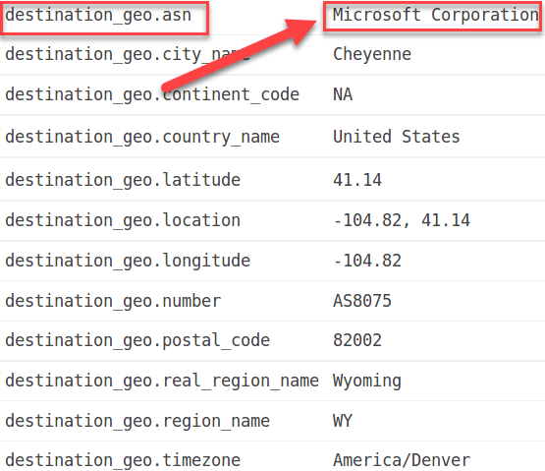
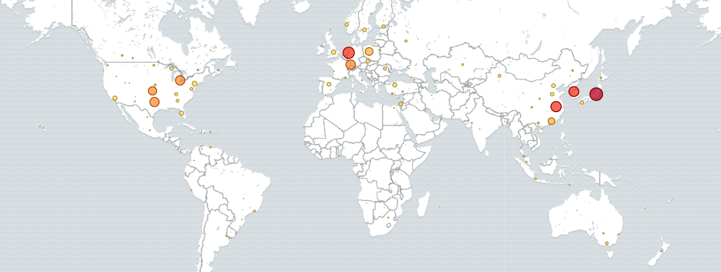
geoip - Filter Plugin
geoip {
source => [ "destination_ip" ]
target => [ "destination_geo" ]
default_database_type => "ASN"
cache => 10000 # default is 1000
}

Slide 22
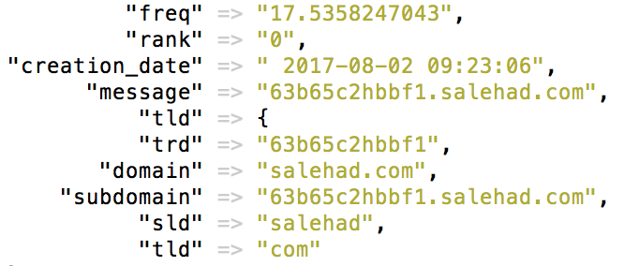
rest - Filter Plugin
request {
request => {
url => http://<host>/%{[tld]}
method => "get"
} }
Enrich FQDNs with lookups to REST API
Threat intelligence – Collective Intelligence Framework
Whois lookups
Passive DNS database
Custom tools like freq_server ("entropy" measure)

Slide 23

elasticsearch - Filter Plugin
Use elasticsearch to query against the top 1M
Uses Elasticsearch during the log pipeline
Elasticsearch is super-fast, and lookups need speed
How fast? On my laptop VM -
Requires top 1M domain data in an index
Automate list download and ingest
Also a great solution for passive DNS/rank
Concept can be used for many other purposes as well
Notes:
How fast? Laptop w/2 CPU & 4GB ram took 250usec – 4k lookups/sec!
Elasticsearch memorize…tbd

Slide 24

ruby - Filter Plugin
When a plugin does not exist, use the magic ruby plugin
Invokes ruby programming language to do "anything"
Requires programming knowledge
Performance can be subpar with poor application
ruby {
code => "event.set('query_length', event.get('query').length)"
}
Calculates length of query and stores in query_length

Slide 25
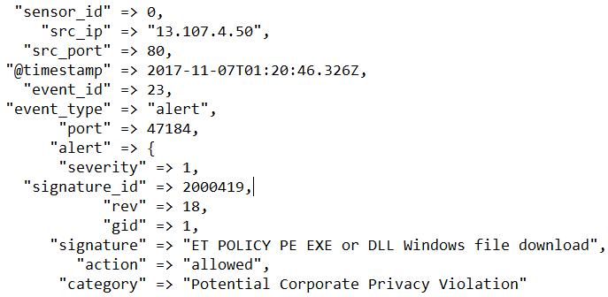
Traditional vs. Modern
Traditional - Syslog
Supported by almost everything
Easy to set up
Painful to parse
Must know fields ahead of time
Modern – JSON, XML, CSV, KV
Not always an option
Almost zero effort to parse
Don't have to know field names ahead of time
Nov 7 01:44:46 ubuntu-455 snort: [1:25385:3] EXPLOIT-KIT Multiple exploit kit Payload detection - calc.exe [Classification: A Network Trojan was detected] [Priority: 1] {TCP} 83.69.233.156:80 -> 10.0.2.15:1031
Or

Slide 26
Enrichment
Logs are prime for enrichment, but many solutions can't
Add domain or IP context with dns plugin
GeoIP / ASN can remove false positives
REST plugin can integrate with many additional tools
Threat intel, entropy measures, whois, etc.
Elasticsearch plugin can do rank/pDNS lookups FAST
Add addition features with ruby plugins
Goal: Eliminate false positives, make analysts lives easier!

